Slide 1

WEB REPORTING
Project Object Analytics

Slide 2
Table of Contents
Reporting Register overview
Create new report
Introduction to Report Register.
First Look at Report Designer.
Open & Save reports.
Introduction to Banded Reports.
Bind to Data.
Reporting Types.

Slide 3
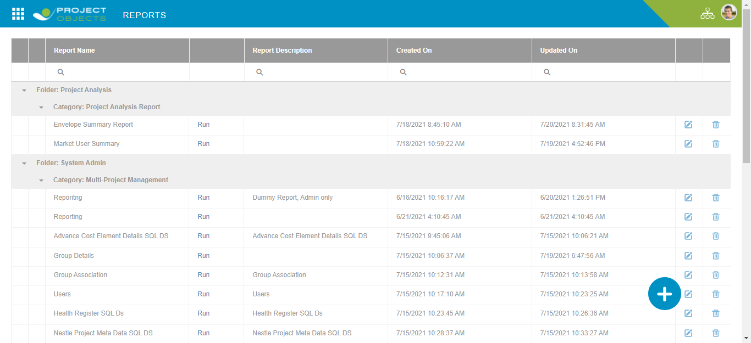
Reporting Register

Slide 4

Create New Report
On Click of Plus Icon user can create new report in analyzer.
By providing the Report information:
Report Name
Description of Report
Folder Name
Category name
Provide accessibility to user / Group from the available list to make the report visible to appropriate users.
Once the changes are Saved, the new report will start appearing in the Report Register.

Slide 5
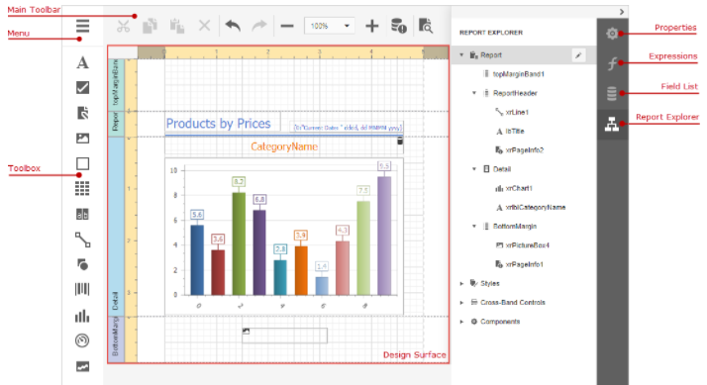
Report Designer
The Design Surface displays a report's structure and contents. You can use the tools on the Report Designer's panels to design the report
Menu – Manage the report
Toolbox to design ,
Main toolbar to editing report
Properties panel to set up report configs,
Expressions to provide data & shape report data ,
Field list to access report ds ,
Report explorer to access report elements.

Slide 6



Open , Save & Delete Reports
OPEN – User can Preview any existing report from Report Register by on click of Run button available next to each report.
DELETE – Using Bin icon next to existing report in Register user can delete reports of no use.
SAVE – When in Report Designer user can save the changes from Report Menu > Save. On Successful save operation it displays the same message.

Slide 7
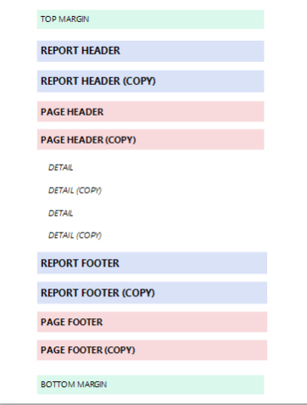
Banded Reports
Report Header and Report Footer – Data here will be displayed only once at the Start & End of Report.
Page Header and Page Footer – to display information on every page
Group Header and Group Footer - These bands are above and below each group we define.
Detail Band - displays contents as many times as there are records available in a data source until you filter it.
Margin bands - These bands are repeated at every page.
Hide Bands in the Report Document
You can avoid printing a band's content in a document. To do this, set the band's Visible property to false. Select the band and set this property in the Properties Panel.

Slide 8
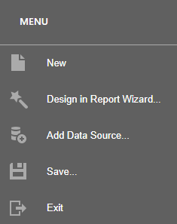
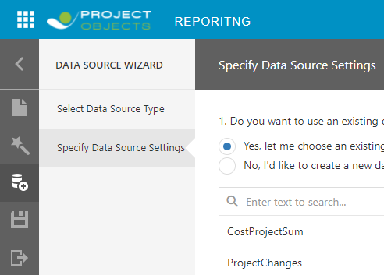
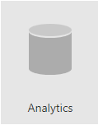
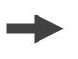
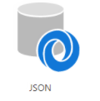
SQL Data Source
Provide Data to Reports
Bind Report to Data Base – to Analytics for SQL Ds & JSON APIs
There are various tables exposed which can be used as Data tables for the Reports.

Slide 9
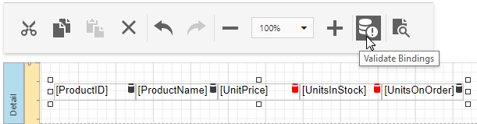
Validate Report Data bindings
After you assign a new data source to a loaded report, the report tries to automatically resolve all data bindings. You can check which the field names of your data source do not coincide with the report controls' bindings.
To do this, click the Main Toolbar’s Validate Bindings command. Report controls with invalid bindings are marked with the icon in the Design Surface.

Slide 10
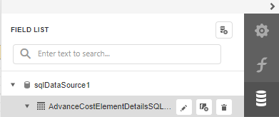
Field List Property

Slide 11
Types of Reports
Empty Report
Table Report
Vertical Report
Label Report
Master Detail Report (Using Sub-Reports)

Slide 12
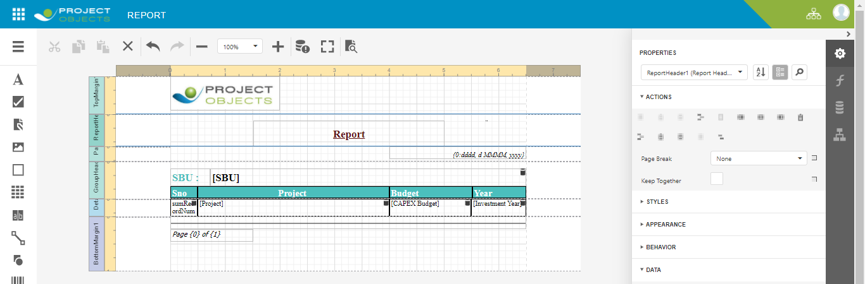
Table Report
To create a table report and generate its layout, select Table Report. Select the data source. Choose fields to display in a report. Add grouping levels. Specify Summary options. Specify report page settings. Specify report color scheme. Set the report title

Slide 13
Vertical Report
It is a table report where record fields are displayed vertically, and data records are printed horizontally

Slide 14
Master Detail Report using Sub Report
To create a master-detail report using the Subreport control. This approach is useful if your data source does not contain master-detail relationship where you prefer to store master and detail reports in different files.
Create a Master Report
Create a new report or open an existing one to use it as a master report.
Bind the report to a required data table.
Drop the required data fields from the Field List onto the Detail band.
Create a Detail Report
Add one more blank report to use it as a detail report.
Bind it to data. For instance, use another table of the same database as for the master report.
Switch to the Field List, select the data fields while holding down CTRL or SHIFT and drag-and-drop them onto the Detail band

Slide 15
Master Detail Report using Sub Report
Add parameter to the detail report. Select the Parameters section in the Field List and click Add parameter.
Click the Edit button for the created parameter and specify the parameter's Name and Type as well as disable the Visible property.
Switch to the Properties panel, expand the Actions category and click the Filter String property's ellipsis button.
In the invoked Filter Editor construct an expression where the required data field is compared to the created parameter. To access the parameter, invoke the drop-down list on the right and select Parameter.
Click Save | Save As in the designer Menu to Save the detail Report to the server-side report storage. In the invoked standard Save dialog, specify the folder and file name.
Embed the Subreport
Open Created Master Report.
Drop the Subreport control from the Toolbox onto the Detail band

Slide 16
Master Detail Report using Sub Report
Expand the Actions category and select the previously saved detail report in the Report Source URL property's drop-down list.
Bind the subreport's parameter used as a filter criterion to the master report's corresponding data field, which serve as a source of the parameter value. To do this, expand the Data category, select the Parameter Bindings section and add a new parameter binding. In the binding properties list, specify the data field to which you want to bind a subreport parameter and the name of the parameter that you want to bind
If required, customize the report's appearance and format values.

Slide 17
Reporting Elements
Basic Elements
Advance Elements
Label
Table
Character comb
Rich Text
Check Box
Picture box
Panel
Page Break
PDF content
Lines & Shapes
Sub report
Table of Contents
Page Info
Chart
Pivot
Barcodes
Gauges
Sparklines
Cross band lines

Slide 18
Basic Elements
Label - Displays plain text in a report.
Rich Text - Displays rich text in a report. You can apply different font settings to the control's content and load content from an external HTML file.
Table - Contains any number of cells arranged in one or more rows. Each table cell can display plain text or contain other controls. (Static & Dynamic info)
Character Comb - Displays each character in a separate cell and can be used to create printed forms
Display Page Information - Use the Page Info control to display information about document pages, such as the current page number and/or total number of pages.
Check boxes - Check boxes can display different states depending on the underlying data values.
Bar Code - To display bar codes, use the Bar Code control.

Slide 19
Basic Elements
Drawing Lines and Shapes - Use the Shape control to draw simple graphics in a report (circles, crosses or arrows).
The Line control enables you to draw straight or slanted lines in a single band.
The Cross-Band Line and Box controls enable you to draw lines and boxes spanning multiple report bands.

Slide 20
Thank You.

